Slide 1
RL Novels
Monte-Carlo Methods
Giovanni GATTI PINHEIRO
August, 28th 2019
AIR-REV-DPI-MLS
Notes:
Cover example with no photo
To update the text, just click on the text
To get more slides with this layout just copy this slide and paste

Slide 2
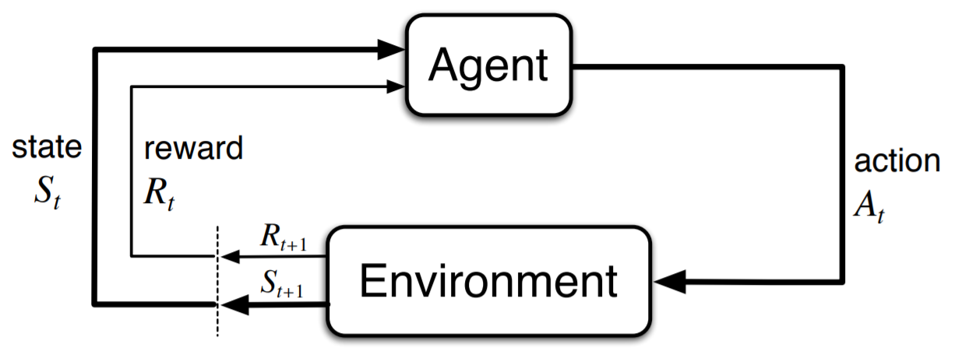
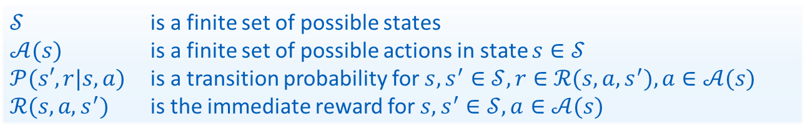
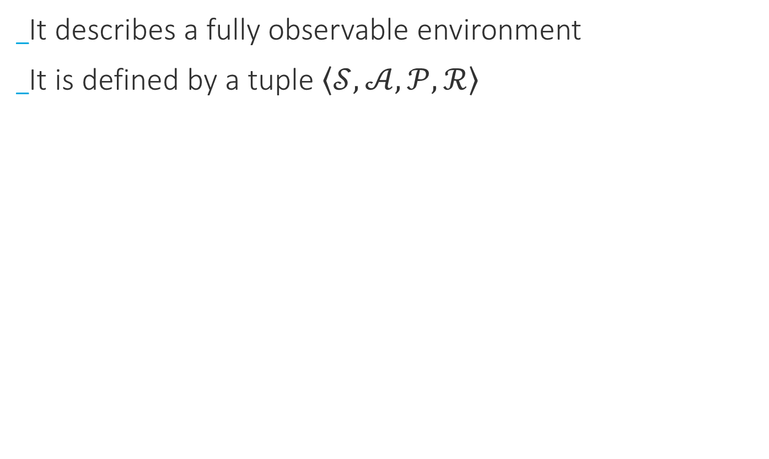
DP review
Markov Decision Process
It describes a fully observable environment
It is defined by a tuple $\left\langle 𝒮, 𝒜, 𝒫,ℛ\right\rangle$
$𝒮$ is a finite set of possible states
$𝒜(s)$ is a finite set of possible actions in state $s∈𝒮$
$𝒫(s′,r|s, a)$ is a transition probability for$s, s^{′}∈𝒮, r∈ℛ(s, a, s^{′}), a∈𝒜(s)$
$ℛ(s, a, s^{′})$ is the immediate reward for$s, s^{′}∈𝒮, a∈𝒜(s)$

Slide 3
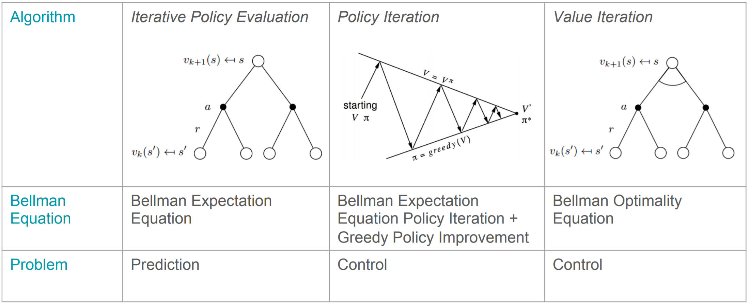
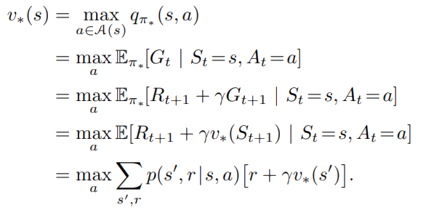
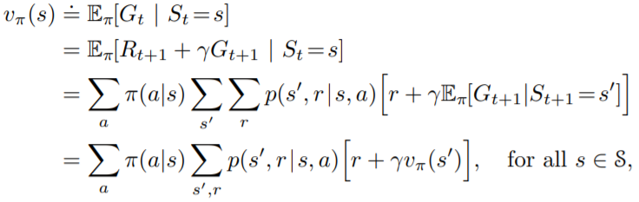
DP review
Algorithms

Slide 4
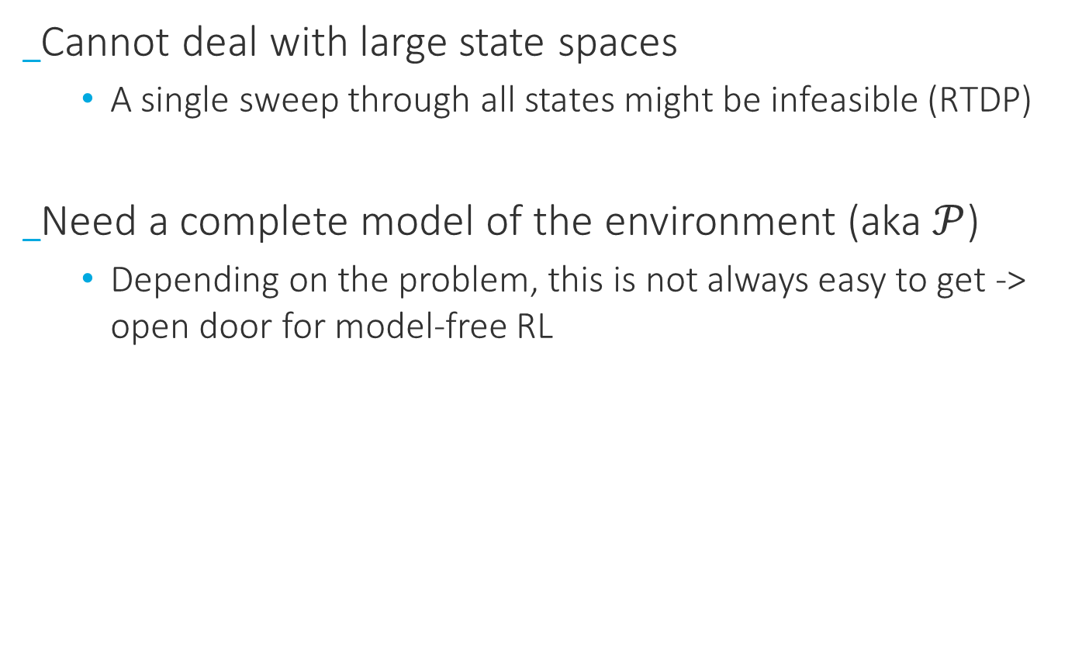
DP review
Drawbacks
Cannot deal with large state spaces
A single sweep through all states might be infeasible (RTDP)
Need a complete model of the environment (aka $𝒫$)
Depending on the problem, this is not always easy to get -> open door for model-free RL

Slide 5
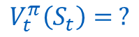
Monte-Carlo Prediction
Intuition
$$V_{t}^{π}\left(S_{t}\right)= ?$$
S_{t}

Slide 6
Monte-Carlo Prediction
Intuition
$$V_{t}^{π}\left(S_{t}\right)= ?$$
S_{t}
…

Slide 7
Monte-Carlo Prediction
Intuition
$$V_{t}^{π}\left(S_{t}\right)= ?$$
S_{t}
…
…

Slide 8
Monte-Carlo Prediction
Intuition
$$V_{t}^{π}\left(S_{t}\right)= ?$$
S_{t}
…
…
…

Slide 9
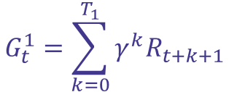
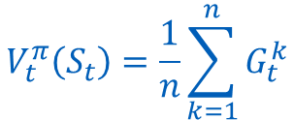
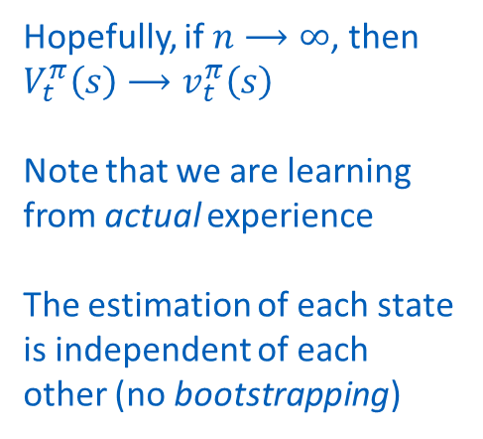
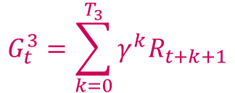
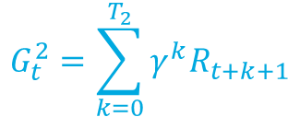
Monte-Carlo Prediction
$$V_{t}^{π}\left(S_{t}\right)=\frac{1}{n}\sum_{k=1}^{n}{G_{t}^{k}}$$
Intuition
S_{t}
Hopefully, if $n⟶∞$, then $V_{t}^{π}\left(s\right)⟶v_{t}^{π}\left(s\right)$
Note that we are learning from actual experience
The estimation of each state is independent of each other (no bootstrapping)
$$G_{t}^{1}=\sum_{k=0}^{T_{1}}{γ^{k}R_{t+k+1}}$$
S_{t+1}
S_{t+1}
S_{t+1}
$$G_{t}^{2}=\sum_{k=0}^{T_{2}}{γ^{k}R_{t+k+1}}$$
$$G_{t}^{3}=\sum_{k=0}^{T_{3}}{γ^{k}R_{t+k+1}}$$
…
…
…
T
T
T

Slide 10

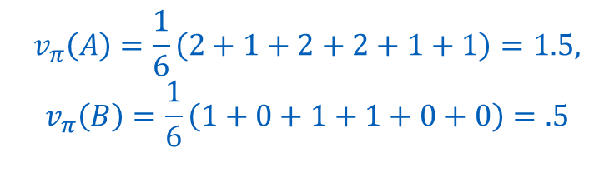
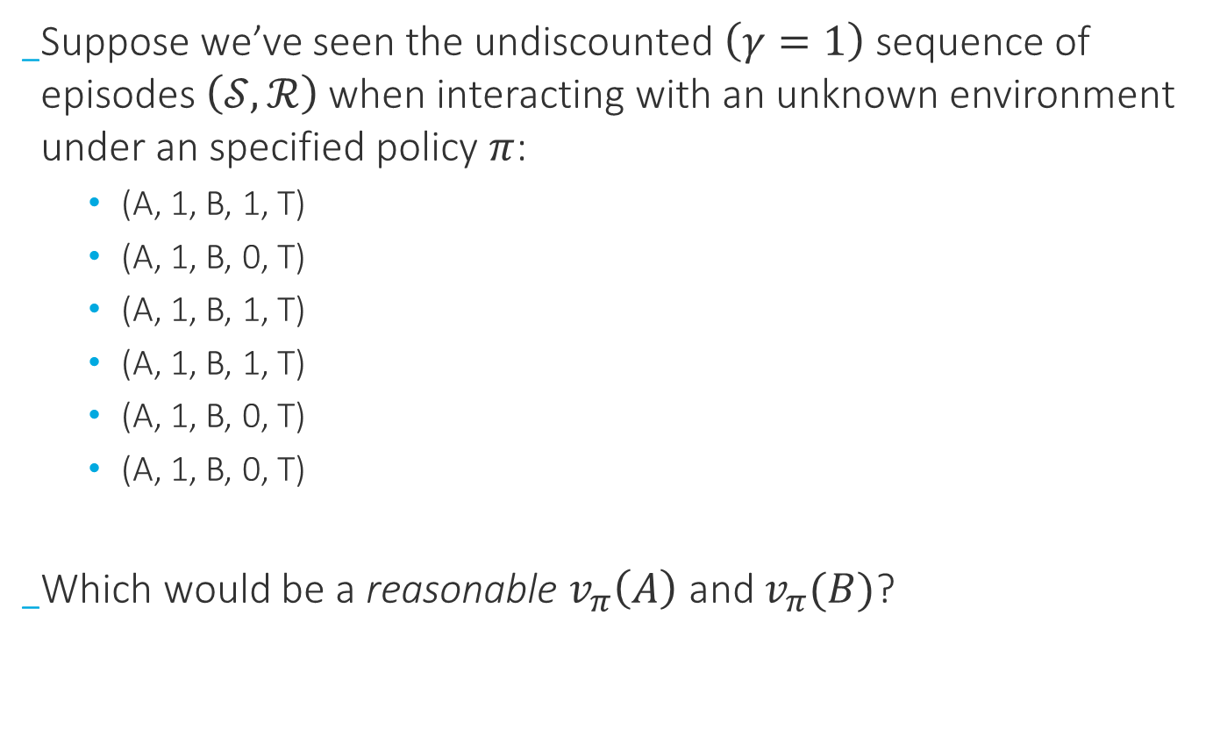


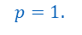
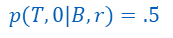
Monte-Carlo Prediction
Intuition
Suppose we’ve seen the undiscounted $\left(γ=1\right)$ sequence of episodes $\left(𝒮,ℛ\right)$ when interacting with an unknown environment under an specified policy $π$:
(A, 1, B, 1, T)
(A, 1, B, 0, T)
(A, 1, B, 1, T)
(A, 1, B, 1, T)
(A, 1, B, 0, T)
(A, 1, B, 0, T)
Which would be a reasonable $v_{π}\left(A\right)$ and $v_{π}(B)$?
$$π\left(r|s\right)=1., ∀s∈𝓢$$
T
+1
A
$$r$$
+1
B
$$p(T,+1|B,r)=.5$$
$$r$$
$$p=1.$$
$$p(T, 0|B,r)=.5$$
0
T
$$v_{π}\left(A\right)=\frac{1}{6}\left(2+1+2+2+1+1\right)=1.5,$$
$$v_{π}\left(B\right)=\frac{1}{6}\left(1+0+1+1+0+0\right)=.5$$

Slide 11
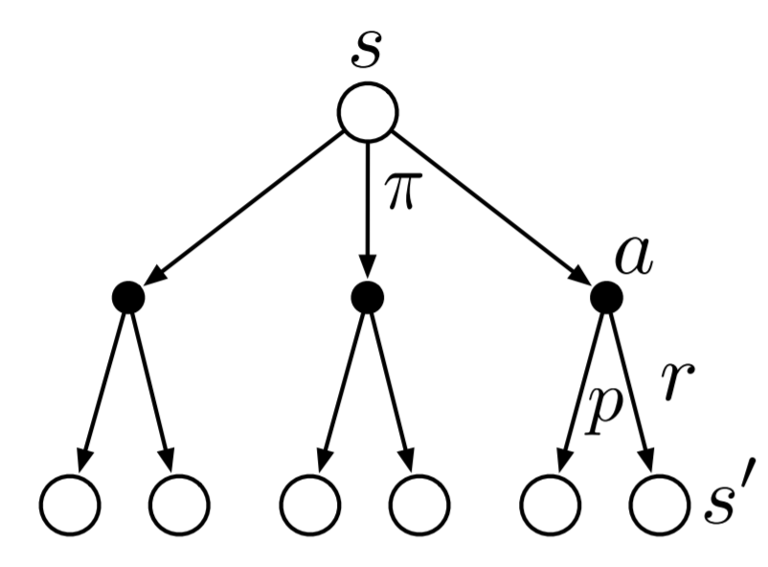
Monte-Carlo Prediction
Intuition
MC methods can learn from simulated (model needs to generate only sample transitions) and actual experience
MC is particularly effective when we need the value of one or a subset of the states (ignoring all others)
Suitable only for episodic tasks
No-bootstrapping
Dynamic Programming backup diagram
Monte-Carlo
backup diagram

Slide 12
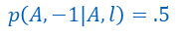
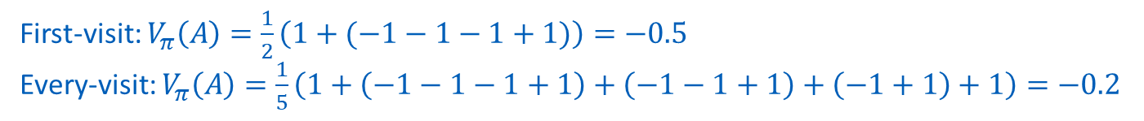
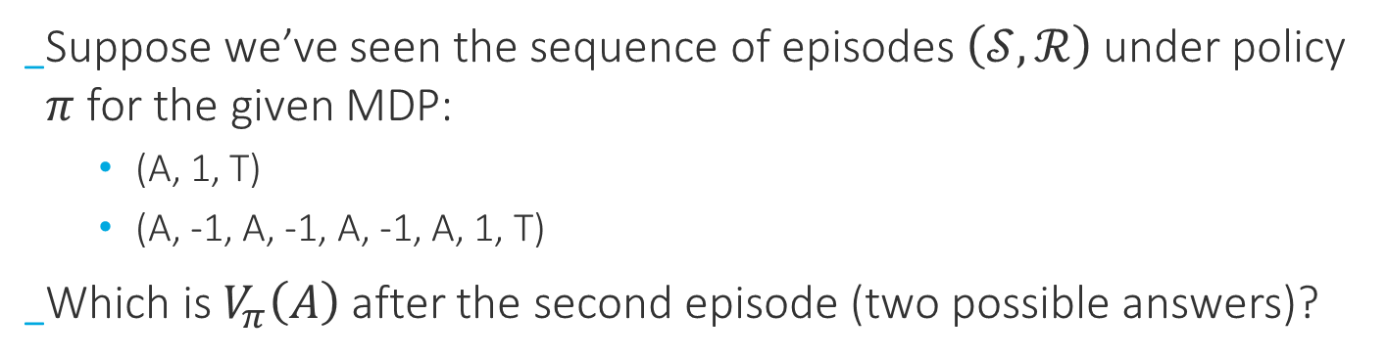
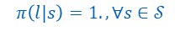
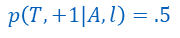
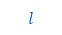
Monte-Carlo Prediction
First/Every-visit
$$p\left(A,−1|A,l\right)=.5$$
A
-1
$$l$$
+1
T
$$p\left(T,+1|A,l\right)=.5$$
$$π\left(l|s\right)=1. ,∀s∈𝒮$$
Suppose we’ve seen the sequence of episodes $\left(𝒮,ℛ\right)$ under policy $π$ for the given MDP:
(A, 1, T)
(A, -1, A, -1, A, -1, A, 1, T)
Which is $V_{π}\left(A\right)$ after the second episode (two possible answers)?
First-visit: $V_{π}\left(A\right)=\frac{1}{2}\left(1+(−1−1−1+1)\right)=−0.5$
Every-visit: $V_{π}\left(A\right)=\frac{1}{5}\left(1+\left(−1−1−1+1\right)+\left(−1−1+1\right)+\left(−1+1\right)+1\right)=−0.2$

Slide 13
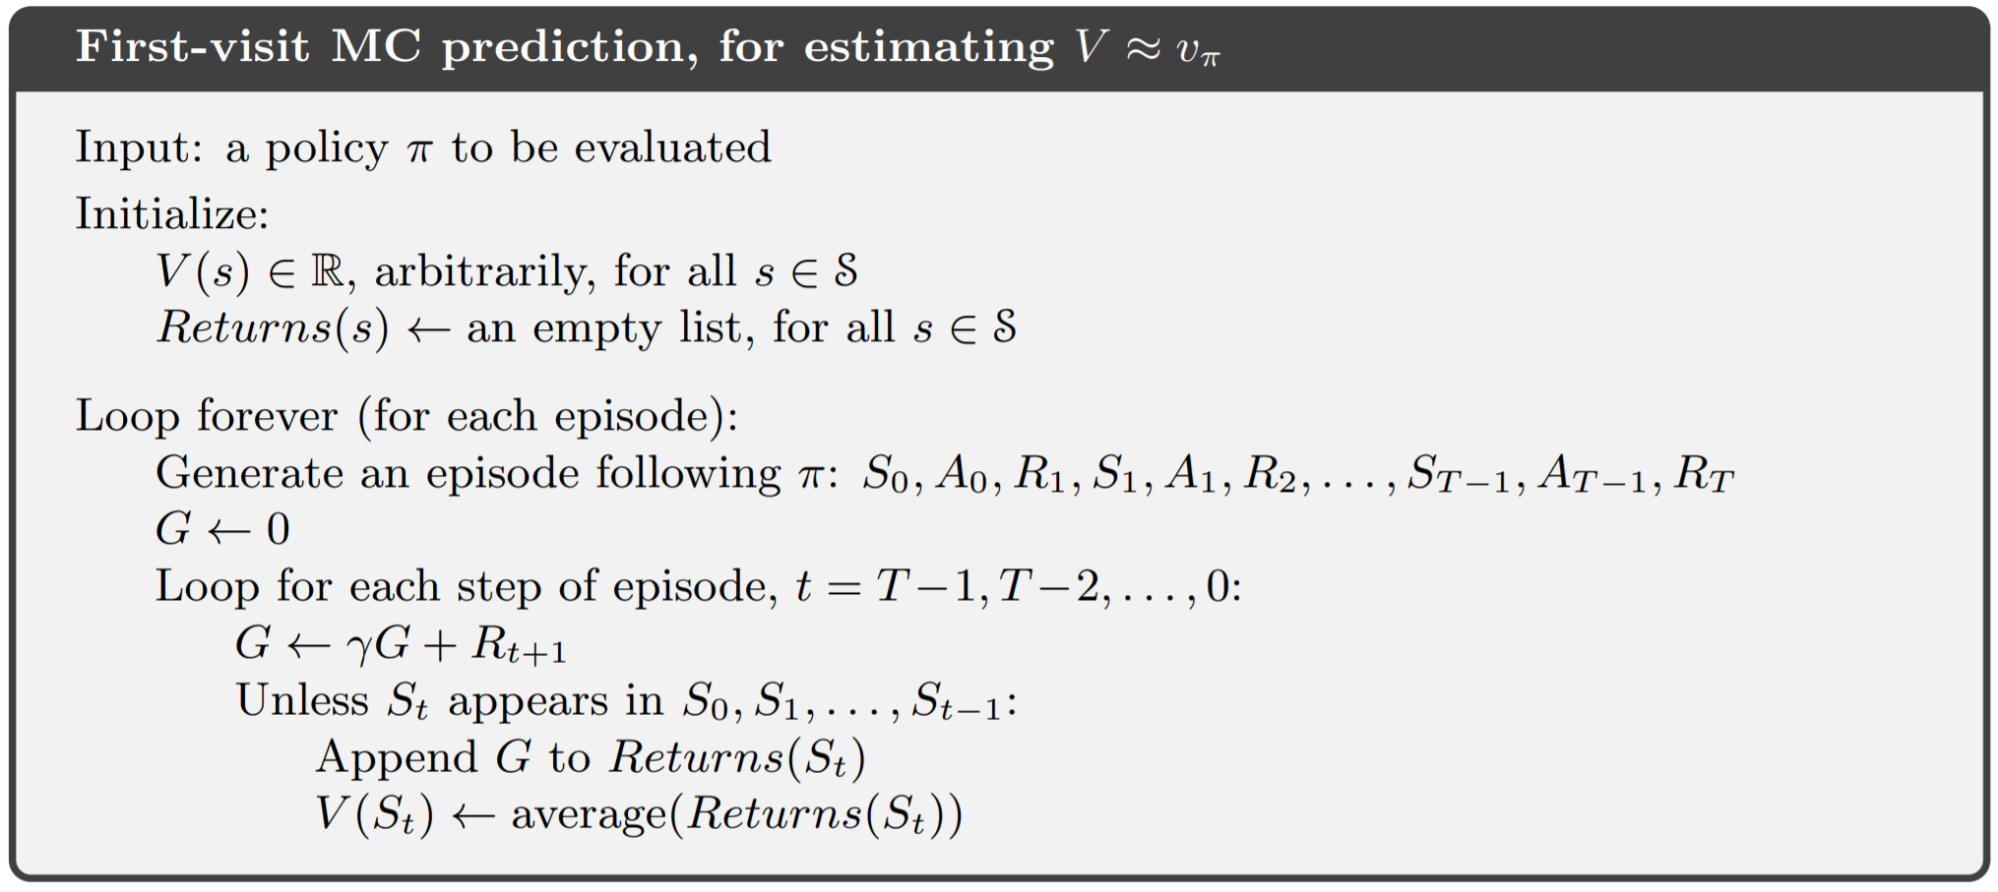
Monte-Carlo Prediction
Pseudocode
No need to keep up the entire history
(one can write the same code with an iterative average)

Slide 14
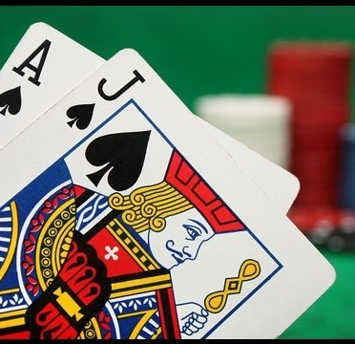
Monte-Carlo Prediction
Blackjack
Goal: obtain the largest sum without exceeding 21
All face cards counts as 10, ace can be either 1 or 11 (usable)
Game starts with two cards (dealt to both dealer and player). One of dealer’s card is face up and the other is face down
If player has 21 (natural) he wins, except if dealer also has a 21 (which is a draw)
If player does not have a natural, he can either request an additional card (hit) or he can stop (stick)
If he exceeds 21, he loses (goes bust), if he sticks, it becomes dealer’s turn

Slide 15
Monte-Carlo Prediction
Blackjack
Dealer hits or sticks with a fixed strategy
Any sum of 17 or greater -> dealer sticks
Otherwise he hits
If dealer goes bust, player wins, otherwise the outcome – win, lose, draw- is determined by whose score is closer to 21
Rewards are +1/0/-1 for winning/draw/losing

Slide 16
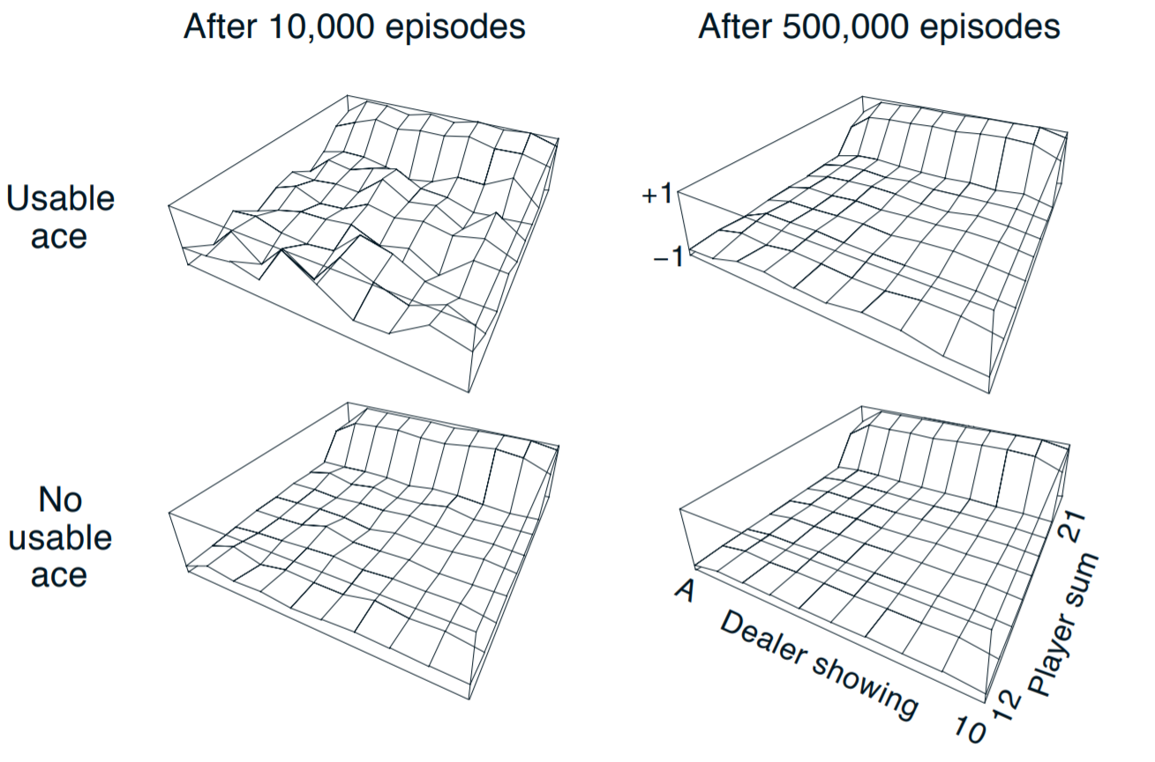
Monte-Carlo Prediction
Blackjack
Approximate state-value functions for blackjack that sticks only on 20 or 21

Slide 17
Monte-Carlo Prediction
Blackjack
Why are estimates for usable ace less “regular”?
Because this states are less commonly visited
Why does the estimated value function jump up for the last two rows in the rear?
Because we are sticking with high chances of winning (20 or 21), and we are going bust anywhere else
Why does it drop off for the whole last row on the left?
Because it is less likely that dealer goes bust if he has an usable ace
Why are the frontmost values higher in the upper diagrams than in the lower?
Because if we have a usable ace, then it is less likely we are going bust when hitting

Slide 18
Monte-Carlo Prediction
Blackjack
The upper graphs were made with first-visit MC. If every-visit MC where used instead, would the results be different?
No, because they both converge to true expectation when number of episodes goes to infinity and there are no loops in this MDP

Slide 19
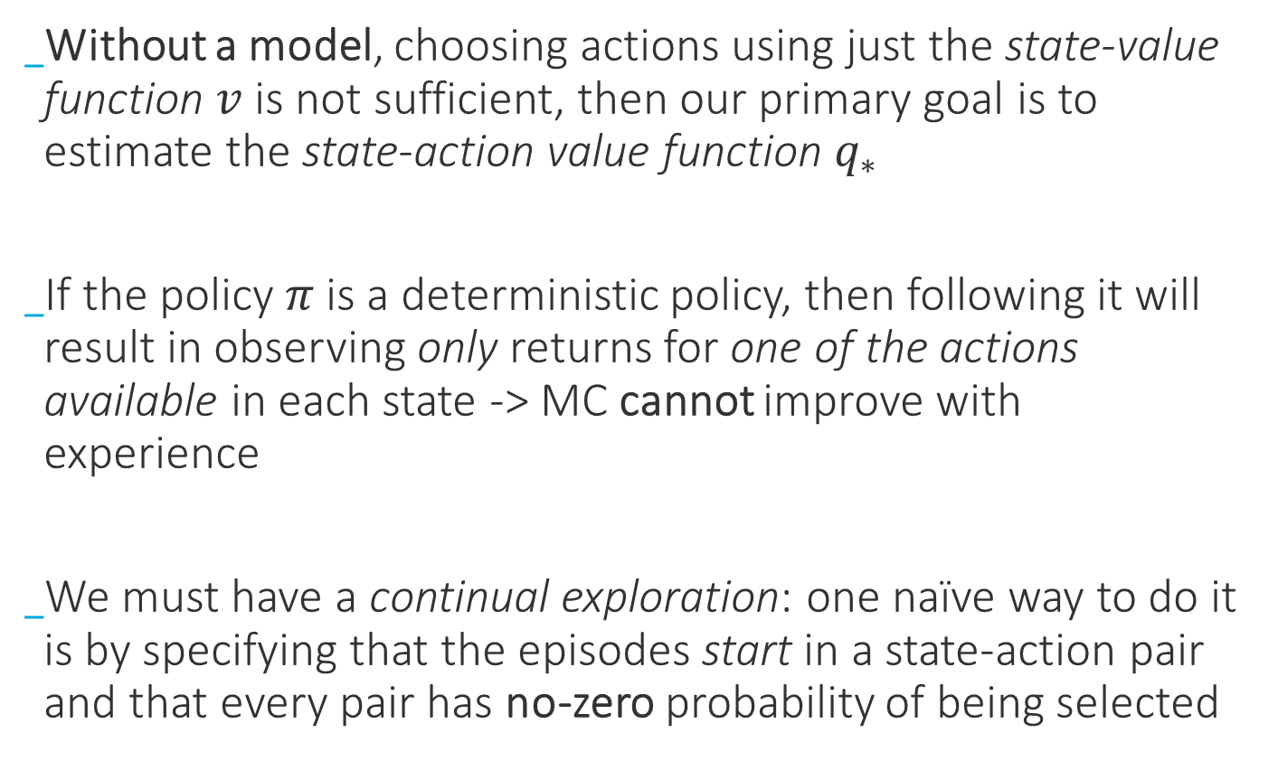
Monte-Carlo Control
Exploring Starts
Without a model, choosing actions using just the state-value function $v$ is not sufficient, then our primary goal is to estimate the state-action value function $q_{∗}$
If the policy $π$ is a deterministic policy, then following it will result in observing only returns for one of the actions available in each state -> MC cannot improve with experience
We must have a continual exploration: one naïve way to do it is by specifying that the episodes start in a state-action pair and that every pair has no-zero probability of being selected

Slide 20
Monte-Carlo Control
Exploring Starts
…
…
…
…
…
…
…
…

Slide 21
Monte-Carlo Control
Exploring Starts
Episode 1
…
…
…
…
…
…
…
…

Slide 22
Monte-Carlo Control
Exploring Starts
Episode 1
…
…
…
…
…
…
…
…

Slide 23
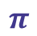
Monte-Carlo Control
Exploring Starts
Episode 1
$$π$$
…
…
…
…
…
…
…
…

Slide 24
Monte-Carlo Control
Exploring Starts
Episode 2
…
…
…
…
…
…
…
…

Slide 25
Monte-Carlo Control
Exploring Starts
Episode 2
…
…
…
…
…
…
…
…

Slide 26

Monte-Carlo Control
Exploring Starts
Episode 2
…
…
…
…
…
…
…
…
$$π$$

Slide 27
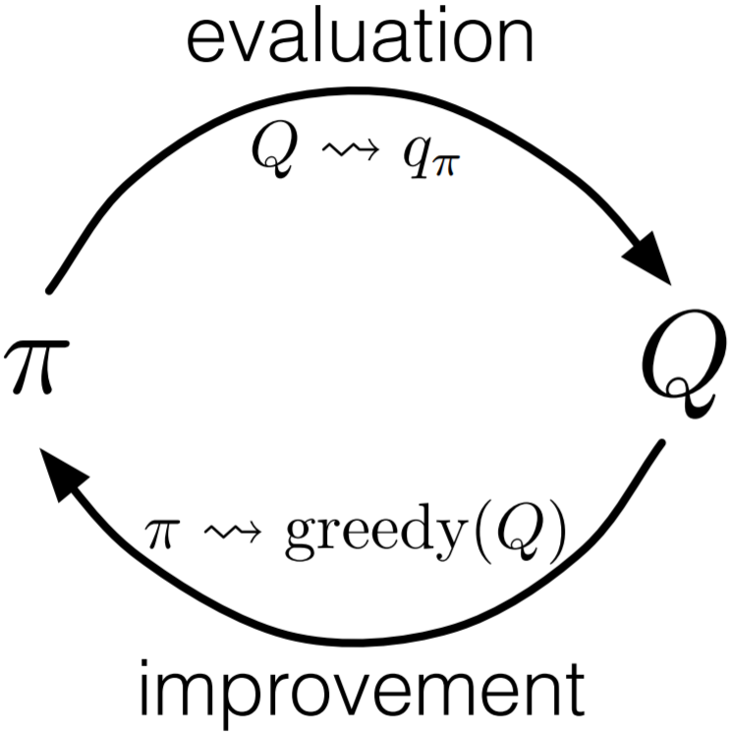
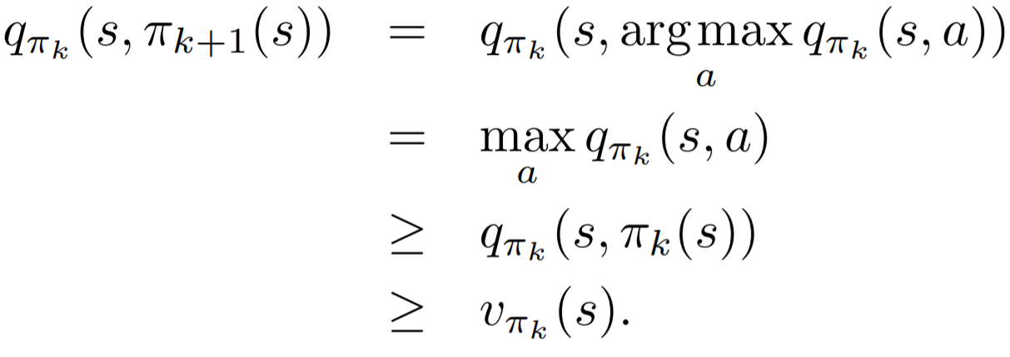
Monte-Carlo Control
Exploring Starts
It is natural to alternate between evaluation and improvement on an episode-by-episode basis
After each episode, the observed returns are improved at all states visited in that episode
Generalized Policy Iteration

Slide 28
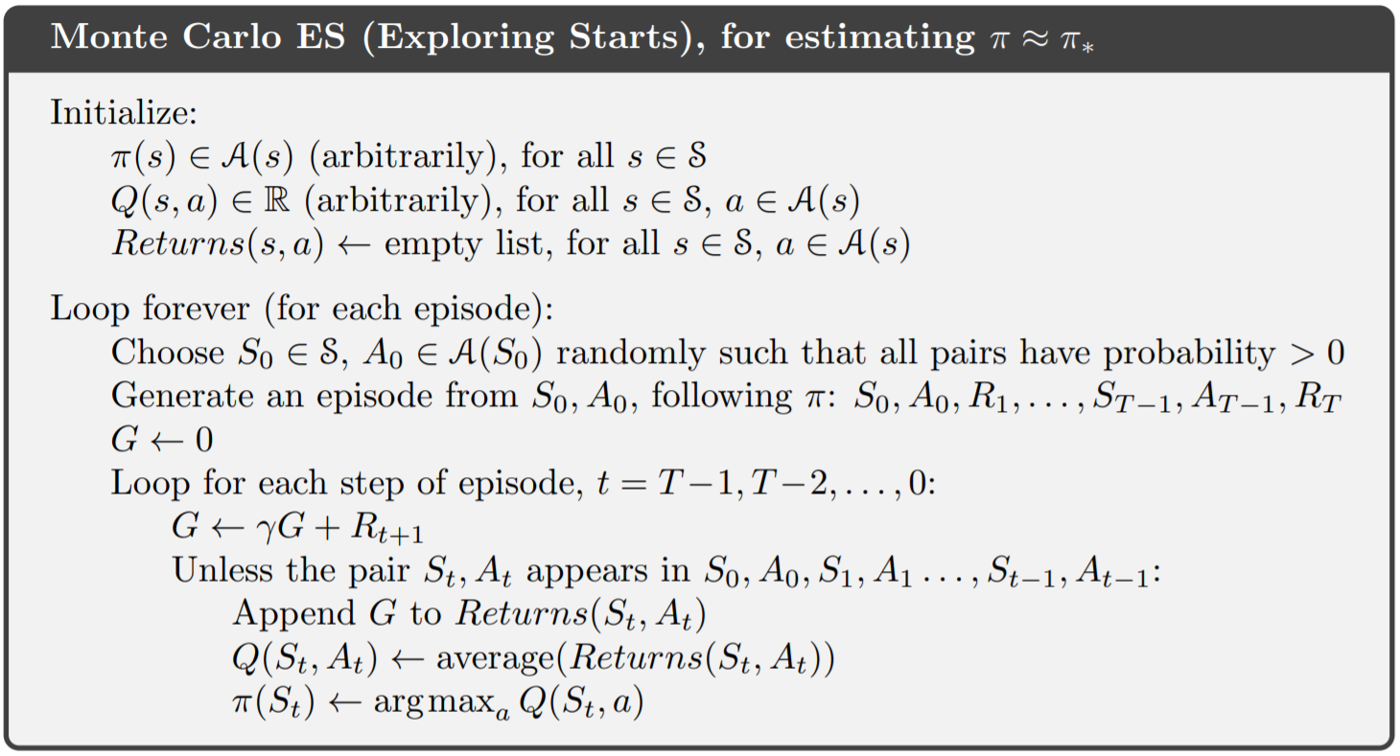
Monte-Carlo Control
Exploring Starts
Convergence seams inevitable, but it has never been formally proved !

Slide 29
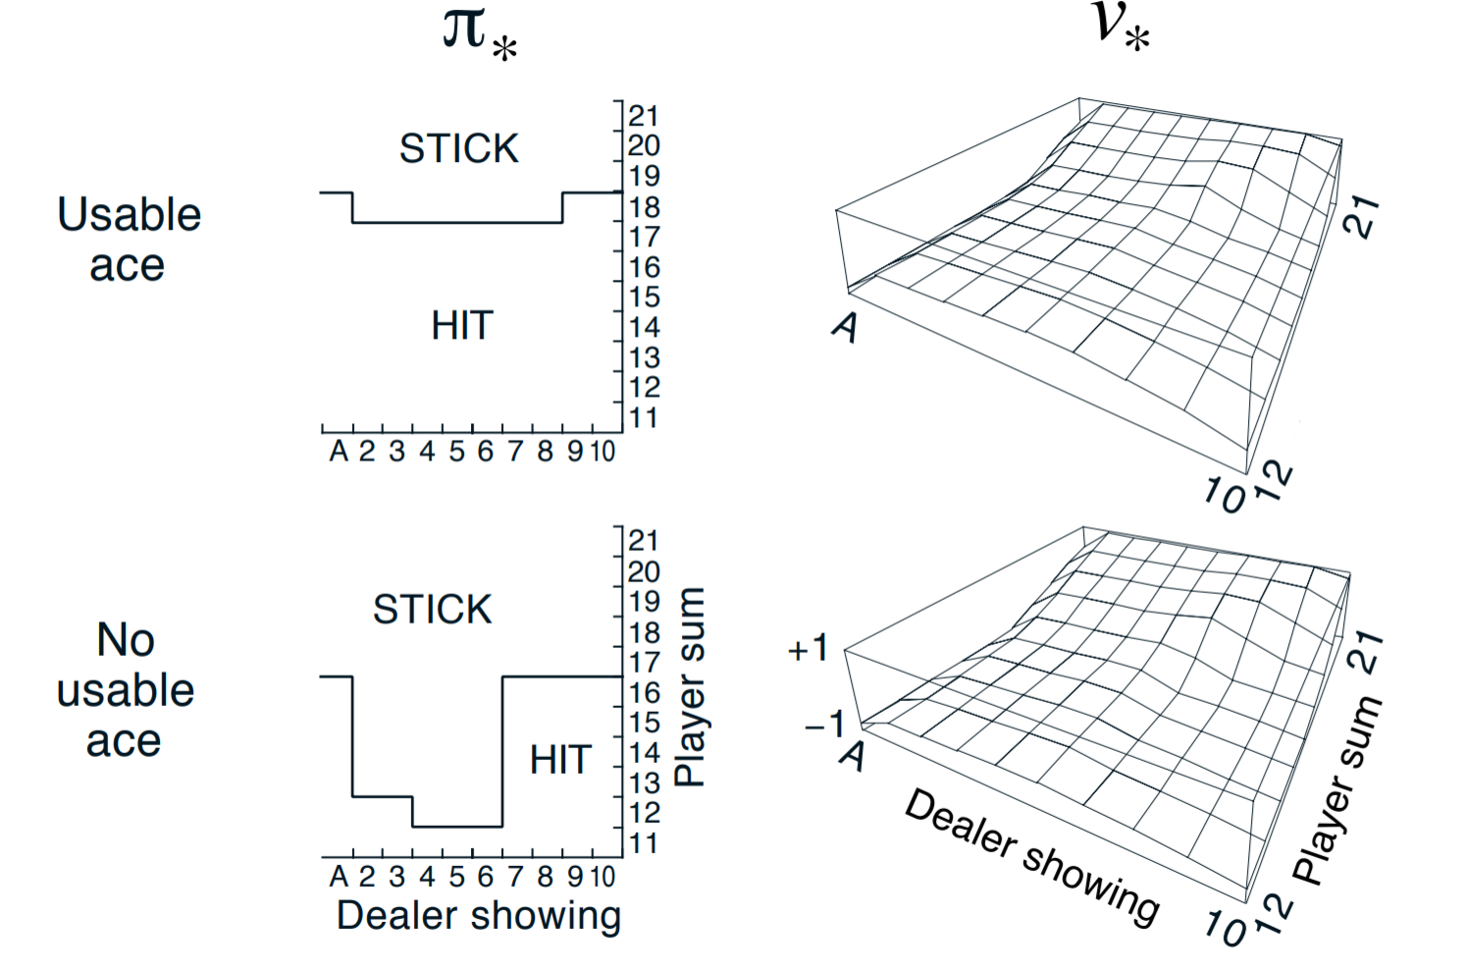
Monte-Carlo Control
Exploring Starts – Blackjack

Slide 30
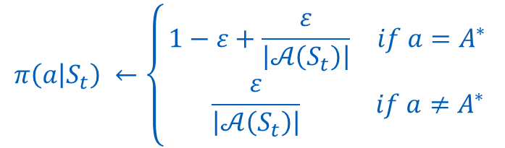
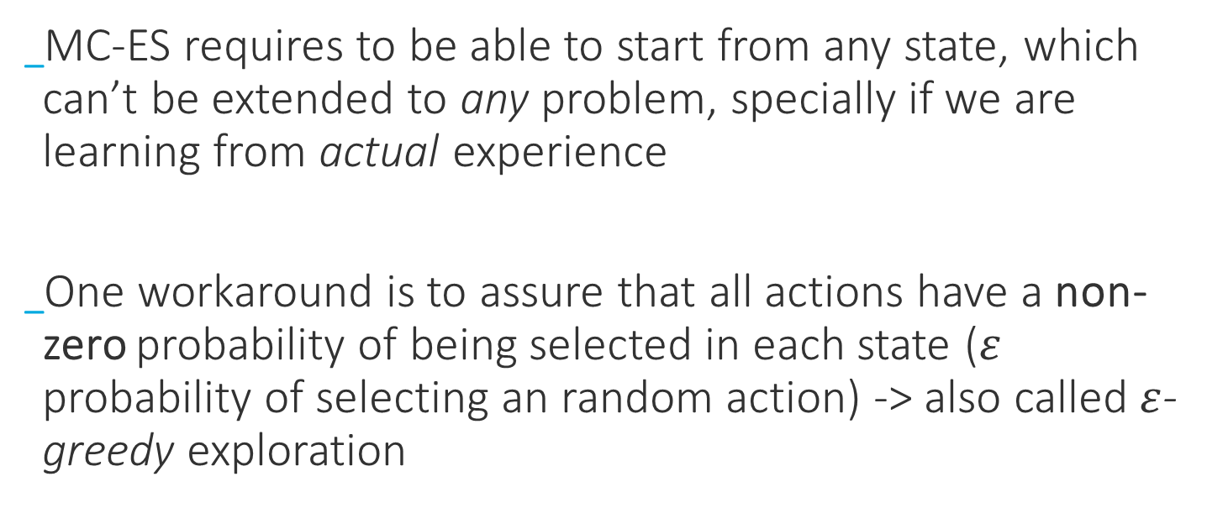
Monte-Carlo Control
Exploring Starts - Drawbacks
MC-ES requires to be able to start from any state, which can’t be extended to any problem, specially if we are learning from actual experience
One workaround is to assure that all actions have a non-zero probability of being selected in each state ($ε$ probability of selecting an random action) -> also called $ε$-greedy exploration
$$π\left(a | S_{t}\right) ←\left\{\begin{aligned}\begin{matrix}1−ε+\frac{ε}{\left|𝒜\left(S_{t}\right)\right|} & if a=A^{∗}\end{matrix} \\ \begin{matrix} \frac{ε}{\left|𝒜\left(S_{t}\right)\right|} & if a≠A^{∗} \end{matrix}\end{aligned}\right.$$

Slide 31
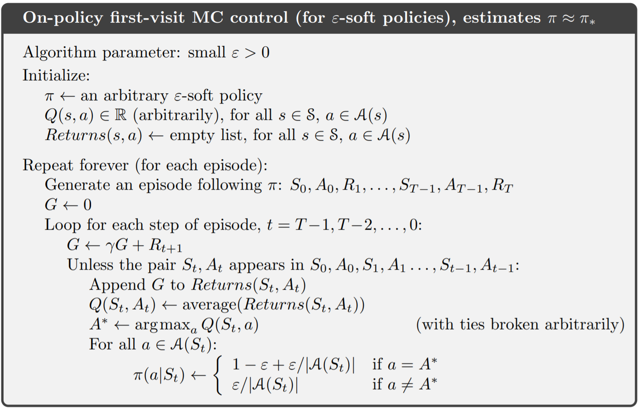
Monte-Carlo Control
On-policy first-visit

Slide 32

Monte-Carlo Control
On-policy / Off-policy Control
There is still a second way to eliminate the exploration starts assumption…
Aha, I wouldn’t do that if I were you!

Slide 33
Monte-Carlo Control
On-policy / Off-policy Control
On-policy methods attempts to improve the policy that is being used to make decisions
Off-policy methods evaluate or improve a policy that different of the one that is generating data -> Learn an optimal policy while following an exploratory policy
Why would that be interesting?

Slide 34
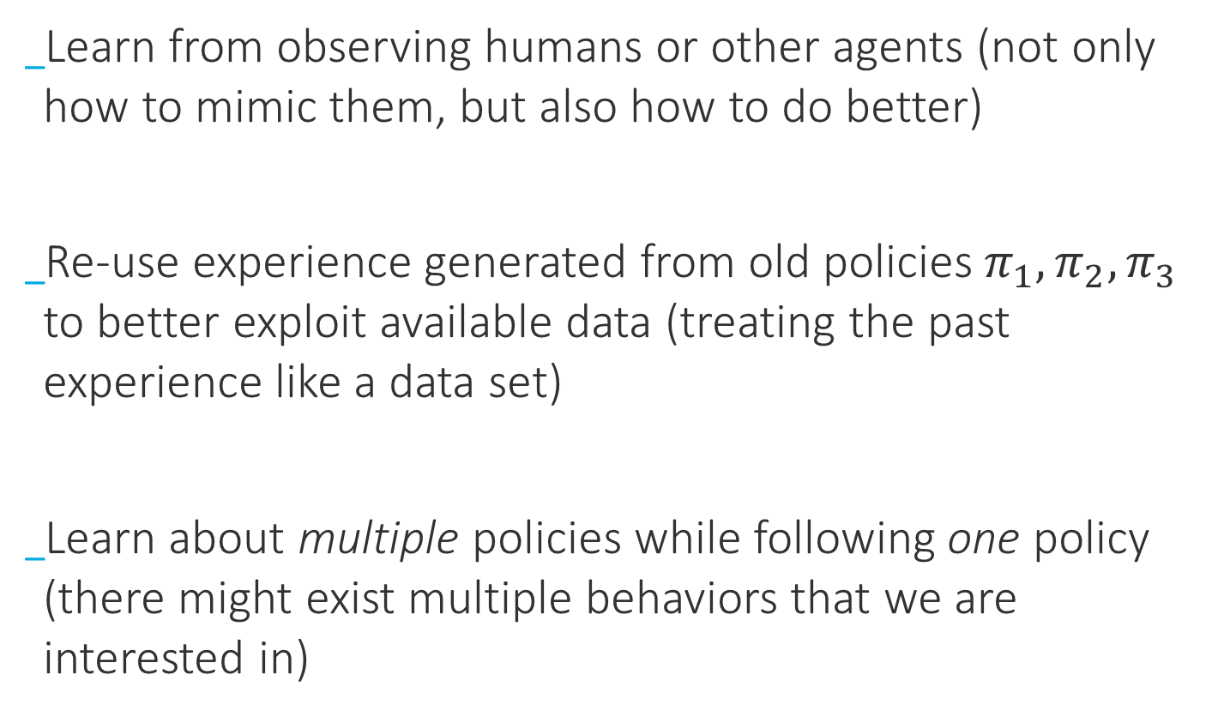
Monte-Carlo Control
Off-policy Control
Learn from observing humans or other agents (not only how to mimic them, but also how to do better)
Re-use experience generated from old policies $π_{1}, π_{2},π_{3}$ to better exploit available data (treating the past experience like a data set)
Learn about multiple policies while following one policy (there might exist multiple behaviors that we are interested in)

Slide 35
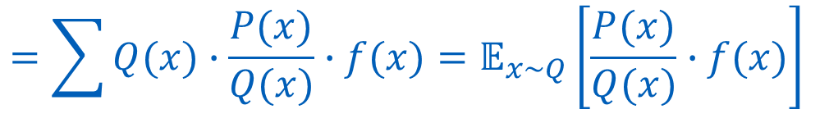
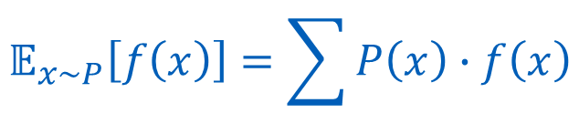
Monte-Carlo Control
Off-policy Control
General idea is to estimate the expectation of a different distribution
Expectation of actual experience
$$𝔼_{x\sim P}\left[f\left(x\right)\right]=\sum{P\left(x\right)∙f\left(x\right)}$$
Expectation of optimal behavior
$$=\sum{Q(x)∙\frac{P(x)}{Q(x)}∙f(x)=𝔼_{x\sim Q}\left[\frac{P(x)}{Q(x)}∙f(x)\right] }$$
Probability distribution P
(behavior/exploratory policy)
(new) Probability distribution Q
(target/optimal policy)

Slide 36
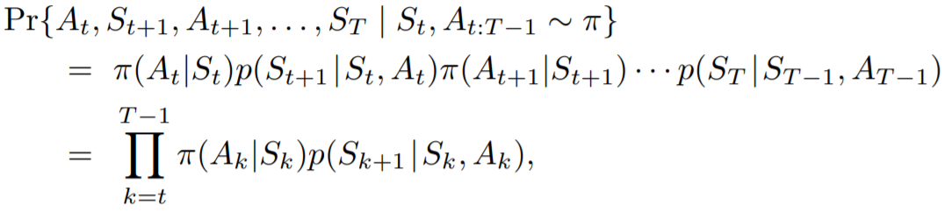
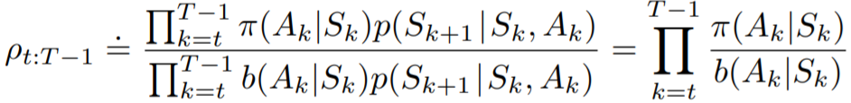
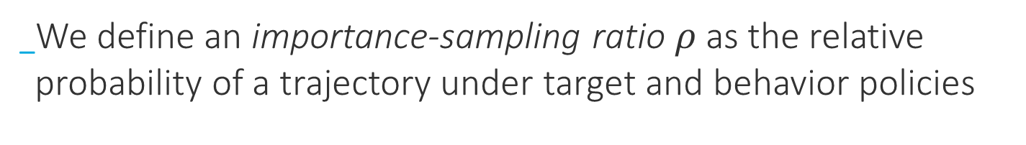
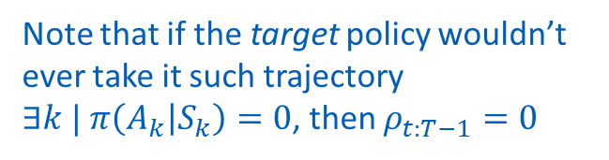
Monte-Carlo Control
Off-policy Control
We define an importance-sampling ratio $ρ$ as the relative probability of a trajectory under target and behavior policies
Note that if the target policy wouldn’t ever take it such trajectory $∃k | π\left(A_{k} | S_{k}\right)=0$, then $ρ_{t:T−1}=0$

Slide 37
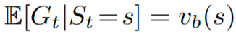
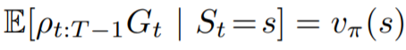
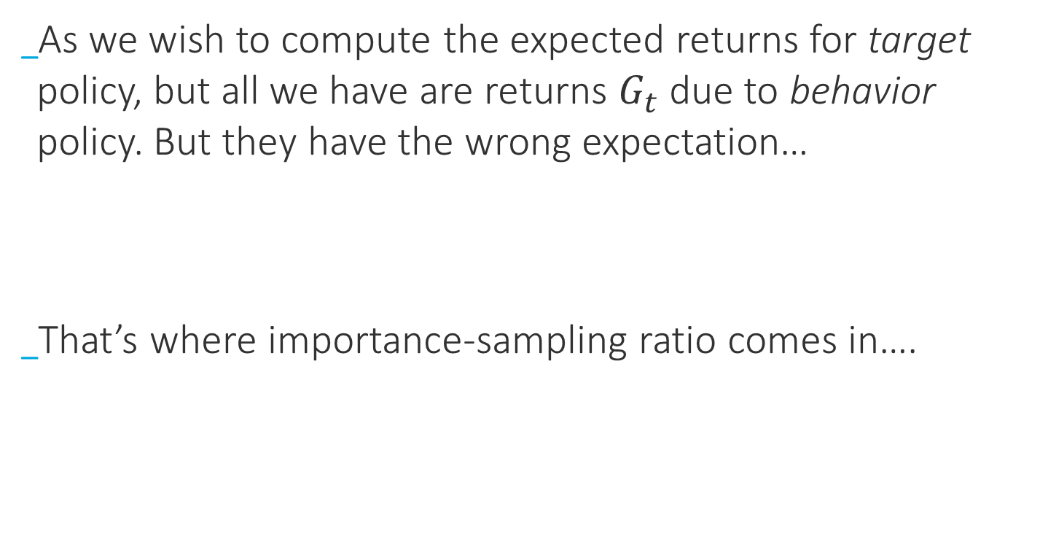
Monte-Carlo Control
Off-policy Control
As we wish to compute the expected returns for target policy, but all we have are returns $G_{t}$ due to behavior policy. But they have the wrong expectation…
That’s where importance-sampling ratio comes in….

Slide 38



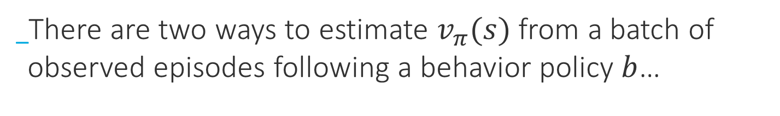
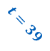

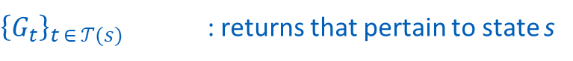
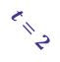
Monte-Carlo Control
Off-policy Control
There are two ways to estimate $v_{π}(s)$ from a batch of observed episodes following a behavior policy $b$…
Episode 1
Episode 2
Episode 3
$$\left\langle s_{t},a_{t}, r_{t}, {s′}_{t}\right\rangle$$
t
$$t=4$$
…
$$t=0$$
$$t=2$$
$$t=40$$
$$t=39$$
$𝒯\left(s\right):$ set of all time steps in which state $s$ is visited (within their episodes)
For first-visit methods
${\left\{G_{t}\right\}}_{t ∈ 𝒯(s)}$ : returns that pertain to state s
${\left\{ρ_{t:T\left(t\right)−1}\right\}}_{t ∈ 𝒯(s)}$ : importance-sampling ratios that pertain to state s

Slide 39









Monte-Carlo Control
Off-policy Control
Episode 1
Episode 2
Episode 3
$$\left\langle s_{t},a_{t}, r_{t}, {s′}_{t}\right\rangle$$
t
…
s
s
s
$$t=4$$
$$t=0$$
$$t=2$$
$$t=40$$
$$t=39$$
$𝒯\left(s\right):$ set of all time steps in which state $s$ is visited (within their episodes)
${\left\{G_{t}\right\}}_{t ∈ 𝒯(s)}$ : returns that pertain to state s
${\left\{ρ_{t:T\left(t\right)−1}\right\}}_{t ∈ 𝒯(s)}$ : importance-sampling ratios that pertain to state s
To estimate $v_{π}(s)$ we simply scale the returns by the ratios and average results
Ordinary importance- sampling

Slide 40


Monte-Carlo Control
Off-policy Control
Episode 1
Episode 2
Episode 3
$$\left\langle s_{t},a_{t}, r_{t}, {s′}_{t}\right\rangle$$
t
…
s
s
s
$$t=4$$
$$t=0$$
$$t=2$$
$$t=40$$
$$t=39$$
$𝒯\left(s\right):$ set of all time steps in which state $s$ is visited (within their episodes)
${\left\{G_{t}\right\}}_{t ∈ 𝒯(s)}$ : returns that pertain to state s
${\left\{ρ_{t:T\left(t\right)−1}\right\}}_{t ∈ 𝒯(s)}$ : importance-sampling ratios that pertain to state s
Another alternative to weight each experience’s return by the likelihood of its trajectory:
$V\left(s\right)≐0$, if $p_{t:T\left(t\right)−1}=0$
Weighted importance- sampling

Slide 41





Monte-Carlo Control
Off-policy Control
To understand the difference between these two, let’s consider a single-return case $\left|𝒯\left(S_{t}\right)\right|=1$, thus
$$=10$$
Unbiased, but may be very extreme
$$V\left(S_{t}\right)= \frac{\sum_{t ∈ 𝒯(s)}{ρ_{t:T\left(t\right)−1}G_{t}}}{|𝒯\left(s\right)|}=ρ_{t:T\left(t\right)−1}G_{t}$$
$$V\left(S_{t}\right)= \frac{\sum_{t ∈ 𝒯(s)}{ρ_{t:T\left(t\right)−1}G_{t}}}{\sum_{t ∈ 𝒯(s)}{ρ_{t:T\left(t\right)−1}}}=\frac{ρ_{t:T\left(t\right)−1}}{ρ_{t:T\left(t\right)−1}}G_{t}=G_{t}$$
Reasonable estimation (the only one we have), but biased: $v_{b}(S_{t})$

Slide 42

Monte-Carlo Control
Off-policy Control – Blackjack

Slide 43







Monte-Carlo Control
$$ρ_{t:T−1}=\prod_{k=t}^{T−1}{\frac{π(A_{p}|S_{k})}{b(A_{p}|S_{k})}}$$
Off-policy Control
$$V\left(S_{t}\right)= \frac{\sum_{t ∈ 𝒯(s)}{ρ_{t:T\left(t\right)−1}G_{t}}}{|𝒯\left(s\right)|}$$
A
+1
$$V\left(S_{t}\right)= \frac{\sum_{t ∈ 𝒯(s)}{ρ_{t:T\left(t\right)−1}G_{t}}}{\sum_{t ∈ 𝒯(s)}{ρ_{t:T\left(t\right)−1}}}$$
$$p$$
+1
T
$$1−p$$
We have a single episode that lasted 10 steps, with a return of 10. What are the first-visit and every-visit $V(A)$?
$$π\left(a | S=A\right)=b\left(a | S=A\right)=1⟺ρ_{t:T−1}=1, ∀t$$
For first-visit method: $\left|𝒯\left(s\right)\right|=1⟹V\left(A\right)=\frac{\sum_{t ∈\left\{0\right\}}{ρ_{0:9}G_{0}}}{1}=G_{0}=10$
For every-visit method: $\left|𝒯\left(s\right)\right|=10⟹V\left(A\right)=\frac{\sum_{t ∈\left\{0, 1,2…, 9\right\}}{ρ_{t:9}G_{t}}}{\sum_{t ∈\left\{0, 1,2…, 9\right\}}{1}}=\frac{G_{0}+G_{1}+…+G_{9}}{10}=\frac{10+9+…+1}{10}=5.5$

Slide 44


Monte-Carlo Control
Off-policy Control
(weighted importance-sampling)
Learning only from the tail of episodes !
Why?
Why not $\frac{π(A_{t}|S_{t)}}{b(A_{t}|S_{t})}$ instead?

Slide 45

Monte-Carlo Control
Racetrack example
Goal: cross the finish line (+1 reward)
Actions: (+1, -1, 0) to all velocity components (restricted to be nonnegative and less than 5)
Rewards are -1 for each step until it crosses the line
If car gets out of track boundaries, he is moved back to a random position on the starting line (with all velocity components set to 0)
Car is not allowed to stop ! (If he has 0 velocity in all components, we accelerate by 1 in a random direction)
(with .1 probability, racer is randomly displaced by 1 square, up or to the right)

Slide 46





Monte-Carlo Control
Racetrack example
$$γ=1$$
$$ε=.1$$
$$episodes: 10 000$$

Slide 47



Monte-Carlo Control
Racetrack example
$$γ=1$$
$$ε=.1$$
$$episodes:?$$

Slide 48



Monte-Carlo Control
Racetrack example
$$ε=.99$$
$$episodes:10 000$$

Slide 49
Thank you!

